Slide 1
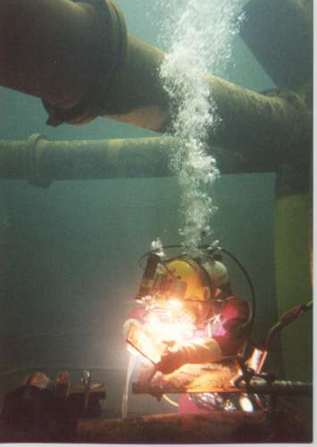
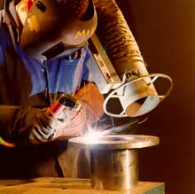
Welding

Slide 2
Welding
A joining process that produces a coalescence of metals by heating them to the welding temperature. With or without the application of pressure and with or without the use of filler metals.
Coalescence is the process by which two or more droplets or particles merge during contact to form a single daughter droplet (or bubble).
The weldability of a material refers to its ability to be welded. Many metals and thermoplastics can be welded, but some are easier to weld than others. It greatly influences weld quality and is an important factor in choosing which welding process to use.

Slide 3
Welding
In welding, two or more metal parts are joined to form a single piece, when one-part fabrication is expensive or inconvenient.
Both similar and dissimilar metals may be welded.
The joining bond is metallurgical (involving some diffusion) rather than just mechanical, as with riveting and bolting.
A variety of welding methods exist, including arc and gas welding, as well as brazing and soldering
During arc and gas welding, the workpieces to be joined and the filler material are heated to a sufficiently high temperature to cause both to melt; upon solidification, the filler material forms a fusion joint between the workpieces.

Slide 4
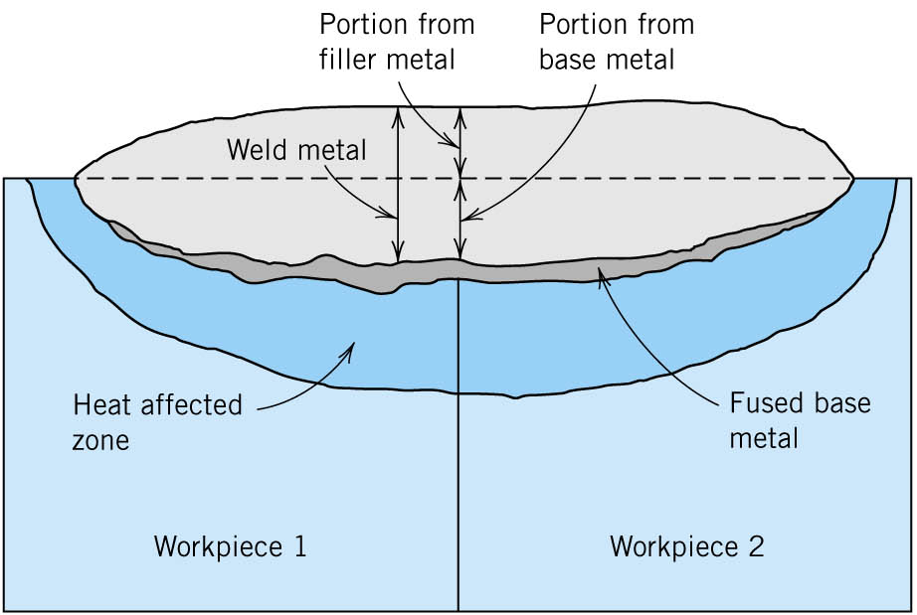
Heat-Affected Zone (HAZ)
The heat-affected zone is the narrow region of the base metal adjacent to the weld bead, which is metallurgically altered by the heat of welding
The heat-affected zone is usually the major source of metallurgical problems in welding
The width of the heat-affected zone depends on the amount of heat input during welding and increases with the heat input
Generally, the heat-affected zone varies from 1.5 mm to 6.5 mm wide (0.06 in to 0.25 in)
FIGURE Schematic cross-sectional representation showing the zones of a typical fusion weld.

Slide 5
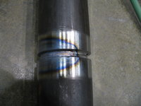
The blue area results from oxidation at a corresponding temperature of 600 °F. This is an accurate way to identify temperature, but does not represent the HAZ width. The HAZ is the narrow area that immediately surrounds the welded base metal.

Slide 6
Edge Preparation before welding
Before starting a weld, the edges should be carefully prepared of similar microstructure metals.
Edges of metal pieces to be joined are made free from free from oxides, grease and dirt by using chemical and mechanical methods.
After cleaning edges are bevelled mechanically for making proper metallurgical joint.
Edges are bevelled with different shapes (single V, double V, Single U, Double U, J, L etc) depending upon the thickness of the work pieces.

Slide 8
Butt Joint
A joint between two members aligned approximately in the same plane

Slide 9
Lap Joint
A joint between two overlapping members

Slide 10
T Joint
A joint between two members located approximately at right angles to each other

Slide 11
Corner Joint
A joint between two members located at right angles to each other

Slide 12
WELDING
PROCESSES

Slide 13
Diversity of welding processes
Welding
Solid state welding
Fusion welding
Soldering and brazing
Resistance welding
Cold welding
Friction welding
Diffusion welding
Flash welding
Ultrasonic welding
Explosion welding
Soldering
Brazing
Electrical energy
Chemical energy
Oxyacetylene welding
Oxyfuel gas welding
Consumable electrode
Non consumable electrode
Other processes
Gas metal arc welding
Shielded metal arc welding
Submerged arc welding
Flux cored arc welding
Electrogas welding
Electroslag welding
Laser beam welding
Thermit welding
Electron beam welding
Gas tungsten arc welding
Atomic hydrogen welding
Plasma arc welding

Slide 14
ARC
WELDING

Slide 15
Arc welding
Arc welding processes use a welding power supply to create and maintain an electric arc between an electrode and the base material to melt metals at the welding point.
They can use either Direct (DC) or Alternating (AC) current, and consumable or non-consumable electrodes. The welding region is sometimes protected by some type of inert or semi inert gas, known as a Shielding gas, and filler material is sometimes used as well.

Slide 16
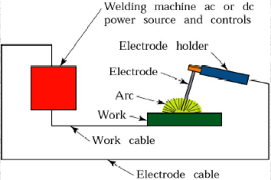
Arc Welding

Slide 17
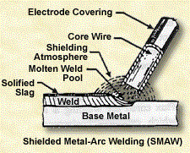

Slide 18
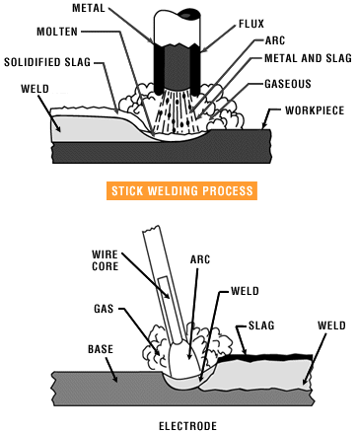
Shielded Metal arc welding

Slide 19
Principle of Arc
An electric arc is formed when an electric current passes between two
Electrodes separated by a short distance from each other.
In arc welding one electrode is the welding rod or wire, while the other
is the metal to be welded.
The arc is started by momentarily touching the electrode on to the
plate and then withdrawing it to about 2 to 3 mm from the plate.
When the electrode touches the plate, a current flows and as it is
withdrawn from the plate the current continues to flow in the form
of a spark across the very small gap first formed.
This causes the air gap to become ionized or made conducting, and as a
result the current is able to flow across the gap, even when it is quite
wide, in the form an arc.

Slide 20
Principle of Arc
The arc is generated by electrons flowing from the negative pole to
the positive pole and the electrical energy is changed in the arc into
heat.
Approximately two-thirds of the heat is developed near the positive
pole, while the remaining third is developed near to the negative
pole.
When alternating current is used, heat is developed equally at the
plate and rod, since the electrode and the plate are changing polarity
at the frequency of the supply.

Slide 21
WELDING EQUIPMENT
Besides the welding machines and suitable electrodes, the accessories necessary for a welder are:
1. A substantial work table with a fairly heavy mild steel plate for a top.
2. Leads. Two are required — one from the machine to the electrode holder, called the electrode lead, and one from the job or work table.
3. Electrode Holders. These should not overheat and have well-insulated handles to avoid electric shocks and accidental arcing.
4. Shields. These are necessary for protecting the eyes and face from light and ultra-violet radiation from the arc, and spatter from the weld pool.
5. Clothing. Leather gloves and apron should be worn.
6. Chipping Hammer. Used for deslagging of welds.
7. Wire Brush. Used for removing rust, cleaning slag off welds, etc.

Slide 22
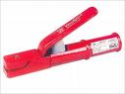
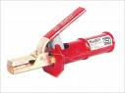
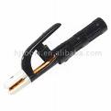
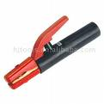
ELECTRODE HOLDERS
Used for holding electrodes.
The body of electrode holders is made of steel, copper etc.
It is well insulated from handle and lever.
Fully insulated electrode holder
Semi insulated electrode holder
Heavy type electrode holder
American electrode holder

Slide 23
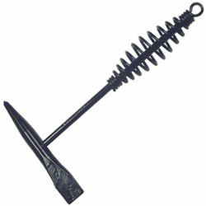
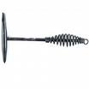
CHIPPING HAMMER
Used for chipping weld slag.
The chisel edge and point very tough and hard, often made of steel.
Chipping hammer
Cross chisel chipping hammer

Slide 24
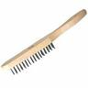
WIRE BRUSHES
Small and fine wires, often of stainless steel are used as brushes.
Function is proper cleaning of fillet welds to provide a smooth surface.
Wire brush (steel)

Slide 25
ARC LENGTH:
The securing of an arc length is necessary to produce a neat weld.
A long arc produces more heat and a very long arc produces a cracking or spattering noise and the weld metal comes across in large, irregular blobs.
A short arc is essential if a high quality weld is to be obtained, although if it is too short there is the danger of it being blanketed by slag and the electrode tip being frozen in.

Slide 26
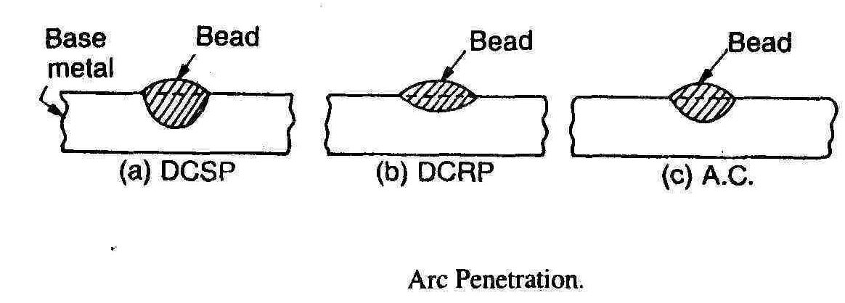
DCSP (Straight Polarity) & DCRP (Reverse Polarity )
The type of current used in arc welding also plays an important role in welding.
Consumable electrode processes such as Shielded metal arc welding and Gas metal arc welding generally use direct current, but the electrode can be charged either positively or negatively. In welding, the positively charged anode will have a greater heat concentration.
DCSP (Direct Current Straight Polarity)
In this the electrode is made cathode , so the work is heated much faster than the electrode as the electrons flow from cathode to anode this causes a deeper penetration at localized position in work piece.

Slide 27
DCRP (Direct Current Reverse Polarity)
In DCRP electrode is positive and the work is negative causing flow of electrons from work to electrode and making electrode consumption faster . This system is preferred in welding thin sections such as in automobile bodies and non ferrous metals.
Alternating current rapidly moves between these two, resulting in medium-penetration welds. One disadvantage of AC, the fact that the arc must be re-ignited after every zero crossing.

Slide 28
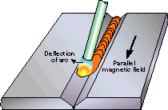
ARC BLOW:
Arc blow is the deflection of the arc away from the weld point.
This is peculiar to DC. The arc, instead of playing steadily on one spot, is deflected away from the point of welding due to the influence of surrounding magnetic fields (Biot-savart law and amperes law) created by welding currents flowing in the work.
It may often be overcome or minimized by shifting the earth clamp to another part of the work piece.

Slide 29
Comparison Between A.C. and D.C. Arc Welding
A.C. arc welding | D.C. arc welding
1. The A.C welding transformer has no moving parts and is simpler. | 1. The D.C. welding generator has rotating parts and is more complicated.
2. The transformer costs less and its maintenance cost is low. | 2. The generator costs more and its maintenance cost is high.
3. Since the distribution of heat is equal, therefore there is no need for changing the polarity. Hence only ferrous metals are usually welded by A.C. | 3. Heat distribution is different in two poles, i.e., two-third in positive and one-third in negative. By changing the polarity, all types of metals can be welded by D.C.
4. All types of electrodes can not be used in A.C. arc welding because the current constantly reverses with every cycle. Only coated electrodes can be used. | 4. All type of electrodes, bare or coated can be used in D.C. arc welding because the polarity can be changed to suit the electrode.
5. The problem of ‘arc blow’ does not arise as it is very easy to control. | 5. In D.C., the ‘arc blow’ is severe and cannot be controlled easily.
6. The arc is never stable. | 6. The arc is more stable.
7. High efficiency of A.C. welding transformers (0.8 to 0.85). | 7. The efficiency of the machine is low (from 0.3 to 0.6).

Slide 30
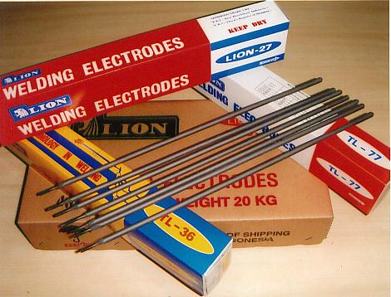
ELECTRODES
In arc welding an electrode is used to conduct current through a work piece
to fuse two pieces together.
Depending upon the process, the electrode is either consumable, as in the
case of gas metal arc welding or shielded arc welding, or non-consumable,
such as in gas tungsten arc welding.

Slide 31
Types of Electrodes.
The electrodes are used for providing heat input in arc welding. Electrodes can be
classified on the following basis :
1) Consumable or Non-consumable. 2) Bare or coated electrodes.
Consumable Electrodes. When the arc is obtained with a consumable electrodes,
the weld metal and the tip of the electrode also gets melted under the arc. Once the
arc is initiated, the electrode is continuously consumed. Thus serving the purpose of
filler rod as well as the heat input to the joint.
Non-Consumable electrode. Non-consumable electrodes are those electrodes,
which are not consumed during welding. Separate filler rods if necessary can be used
to fill the gap along the joints. Non-consumable electrodes are made of carbon,
graphite or tungsten. The carbon and graphite electrodes are used only in D.C.
welding, whereas tungsten electrodes are used for both D.C. and A.C. welding.
Non-consumable electrodes are used in carbon arc welding or tungsten inert gas arc
welding (TIG).

Slide 32
Bare Electrode. If the electrode is not coated with flux, it is called the bare
electrode. In that case flux will be added separately if necessary. Bare electrodes are
used in carbon arc welding and tungsten arc welding. The striking of arc is difficult
with this type of electrode especially with A.C. supply.
Coated Electrode. If the electrode is coated with flux, it is called the coated
electrode The coating on the electrodes serves many purposes. The coated
electrode also called "stick" electrodes is available in the length 350 or 450mm.
One of the major concerns with the coated electrodes, is the moisture pick up
by the coating. This moisture, dissociate into oxygen and hydrogen with the
hydrogen being absorbed by the liquid metal and subsequently released during
solidification, causing porosity.

Slide 33
THE WELDING ELECTRODE
METAL ARC welding electrodes consist of a core wire surrounded by a flux coating. The flux coating is usually applied to the core wire by an extrusion process, but a few types of electrodes are still made by dipping the core wire into a thick slurry of fluxing material and drying out between the application of successive layers.
Electrode Coatings :
1. Slag forming ingredients: Asbestos, mica, silica, fluorspar, titanium dioxide, Iron oxide, magnesium carbonate, Calcium carbonate and aluminium oxide.
2. Arc stablising ingredients, or ionizing agents : Potassium silicate, TiO₂ + ZrO₂ (Rutile), Mica, Calcium oxide, sodium oxide, magnesium oxide, feldspar (KAl Si₃ O₈).
The major types of feldspars are :-
(i) Potash feldspar, K₂O . Al₂O₃ . 6SiO₂
(ii) Sodium feldspar, Na₂O . Al₂O₃ . 6SiO₂
(iii) Lime feldspar, CaO . Al₂O₃ . 6SiO₂
3. Deoxidizing ingredients. Cellulose, Calcium carbonate, dolo- mite, starch, dextrin, wood flour, graphite, aluminium, ferroinanganese.
4. Binding materials. Sodium silicate, potassium silicate, asbestos.
Alloying constituents to improve strength of weld. Ti O₂ and potassium
compounds increase the melting rate of the base metal for better penetration.
7. Iron powder provides higher deposition rate.

Slide 34
Functions of Coatings
Improves arc stability by providing certain chemicals which have this
ability, by ionizing the path of arc.
Provides a protective gaseous atmosphere to prevent O_{2,} and N₂
pick-up by the molten metal.
Provides a protective slag over hot metal.
4. Provides flux, which helps to remove oxides and other impurities from
the molten weld metal.
5. Reduces spatter of weld metal - when coating burns off slower than
core.
Adds alloying elements.
Increases deposition efficiency.
8. Slows down the cooling rate of weld (due to protective layer of slag) to prevent hardening.
9. Coatings are normally insulators of electricity and so permit the use of
electrodes in narrow grooves etc.

Slide 35
Shielding gases
They are inert or semi-inert gases that are commonly used in several welding processes, mostly in MIG and TIG. Their purpose is to protect the weld area from atmospheric gases, such as oxygen, nitrogen and water vapor.
Common shielding gases
Shielding gases fall into two categories—inert or semi-inert.
Only two of the noble gases, helium and argon , are cost effective enough to be used in welding.

Slide 36
Advantages of inert gas shielding arc
Much greater penetration and the higher welding speeds are possible, because of the higher current which can be used.
There is no slag to clean off after welding, because no flux is used.
Produce very high quality and clean welds on almost any material in any welding position.
The weld zone is visible.
No possibility of cracks.
There is no weld spatter.
It is fast and economic because there are no frequent changes of the electrodes, as with stick type electrodes.

Slide 37
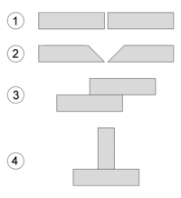
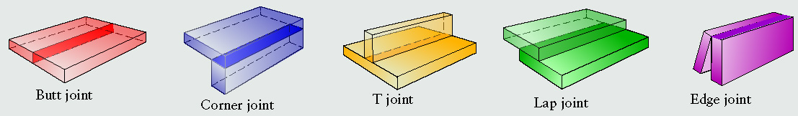
Common welding joint types – (1) Square butt joint, (2) Single-V preparation joint, (3) Lap joint, (4) T-joint.

Slide 38
Welding Positions
INCREASING DIFFICULTY
FLAT
HORIZONTAL
OVERHEAD
VERTICAL

Slide 39

DIFFERENT
METHODS
OF
ARC WELDING

Slide 40
Shielded metal arc welding
One of the most common types of arc welding is Shielded metal arc
welding (SMAW), which is also known as Manual metal arc welding
(MMA) or stick welding.
Electric current is used to strike an arc between the base material and
consumable electrode rod.
The electrode core itself acts as filler material. The process is very
versatile, requiring little operator training and inexpensive equipment.
Weld times are rather slow, since the consumable electrodes must be
frequently replaced and because slag, the residue from the flux,
must be chipped away after welding
The versatility of the method makes it popular in a number of
applications, including repair work and construction

Slide 41
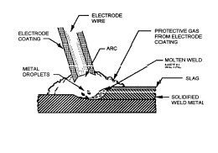
Shielded Metal Arc Welding
From the figure a slag can be seen. This slag combines with the electrode coating and forms a protective barrier for the weld. This barrier protects the weld from the outside air and keeps out contaminates.

Slide 42
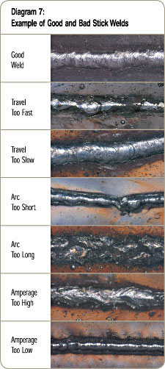
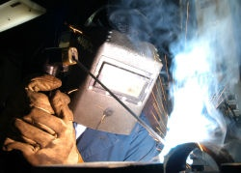
Examples of SMAW Welds

Slide 43
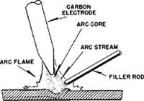
CARBON ARC WELDING
Carbon arc is an old welding method which uses
relatively low voltage, high amperage electricity to
heat metal when an arc is established between a
carbon electrode and the work (single-carbon arc)
or between two such electrodes (twin-carbon arc).
Carbon arc welding is also used for metal removal
rather than metal joining.
Single-carbon arc welding, utilizes a DC power source, usually connected with the straight polarity.
A problem with single-carbon welding was the likelihood of the weld puddle being contaminated by bits of carbon from the electrode.
Twin-carbon arc have two arms which affix the twin electrodes, at some angles to each other.
The operator manipulates the moving arms to touch the electrode tips together momentarily to initiate current flow, then moves them apart to achieve the desired gap. The resultant electric arc across the gap serves as a heat source to bring the workpiece to a temperature at which filler rod can be added.

Slide 44
GAS METAL ARC WELDING (MIG)
(GMAW), also known as metal inert gas (MIG) welding, is a semi-automatic or automatic welding process that uses a continuous wire feed as an electrode and an inert or semi-inert gas mixture to protect the weld from contamination.
Since the electrode is continuous, welding speeds are greater for GMAW than for SMAW.
However, because of the additional equipment, the process is less portable and versatile, but still useful for industrial applications.
The process can be applied to a wide variety of metals, both ferrous and non-ferrous.

Slide 45
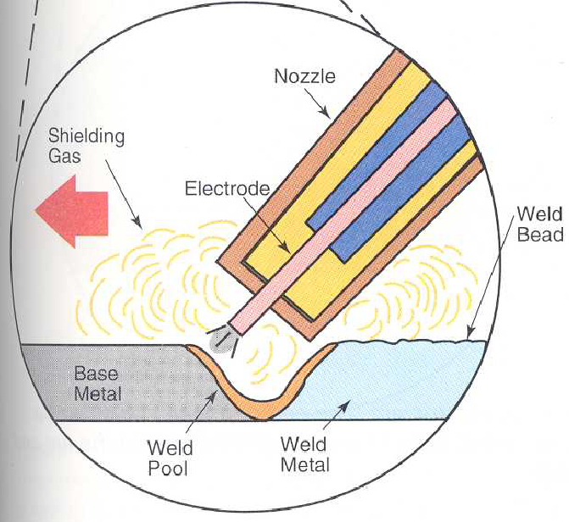
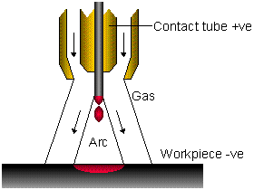
Gas Metal Arc Welding
The heat is produced by an electric arc between the continuously fed metal electrode and the base metal. Both the base metal and the filler are melt. The weld area is protected by inert shield gases.

Slide 46
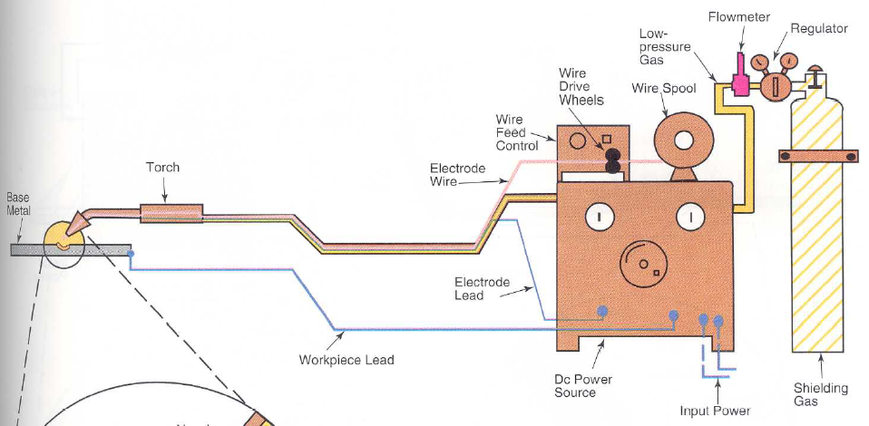
Main equipment
Torch - Electric power source
Shielding gas source -Wire spool with wire drive control
Equipment required for the GMAW
(Modern Welding (p63))

Slide 47
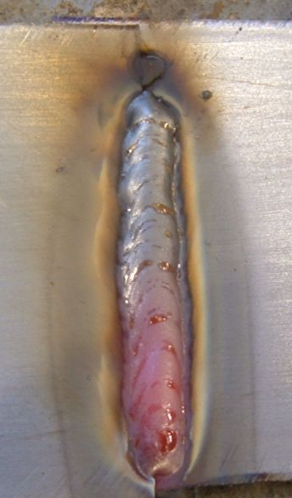
Advantages of the GMAW
A fair/typical quality MIG weld (still hot!)
Wide range of weldable metals
Easy to learn
Can be used in all welding position
Can be easily automated.
Rapid, economic
High level of productivity

Slide 48
Submerged Arc Welding (SAW)
Submerged Arc Welding (SAW) is a common arc welding process. It requires
a continuously fed consumable electrode.
The molten weld and the arc zone are protected from atmospheric
contamination by being “submerged” under a blanket of granular flux.
SAW is normally operated in the automatic mode, however, semi-automatic
(hand-held) SAW guns are also available. Deposition rates approaching
45 kg/h have been reported ,this compares to ~5 kg/h (max) for SMAW.
Current ranging from 200 to 1500 A are commonly used.
Single or multiple (2 to 5) electrode wire variations of the process exist.
SAW strip-cladding utilizes a flat strip electrode.
DC or AC power can be utilized on multiple electrode systems.
Constant Voltage welding power supplies are most commonly used.

Slide 49
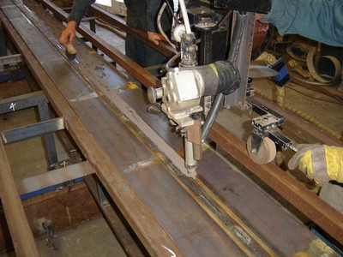
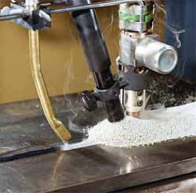
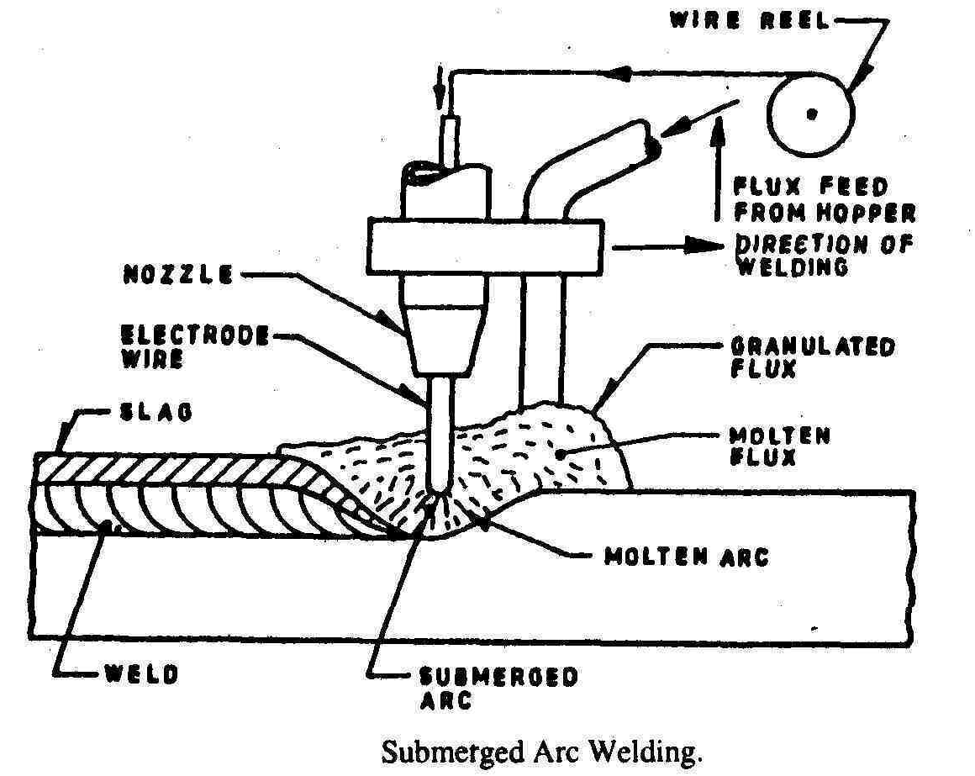

Slide 50
Material applications
Carbon steels (structural and vessel construction);
Low alloy steels;
Stainless Steels;
Nickel-based alloys;
Surfacing applications (wearfacing, build-up, and corrosion resistant overlay of steels).
Advantages of SAW
High deposition rates (45 kg/h) have been reported).
Deep weld penetration.
Sound welds are readily made (with good process design and control);
High speed welding of thin sheet steels at over 100 in/min (2.5 m/min) is possible;
Minimal welding fume or arc light is emitted.
Limitations of SAW
Limited to ferrous (steel or stainless steels) and some nickel based alloys;
Normally limited to long straight seams or rotated pipes or vessels;
Requires relatively troublesome flux handling systems;
Flux and slag residue can present a health & safety issue;
Requires post weld slag removal

Slide 51
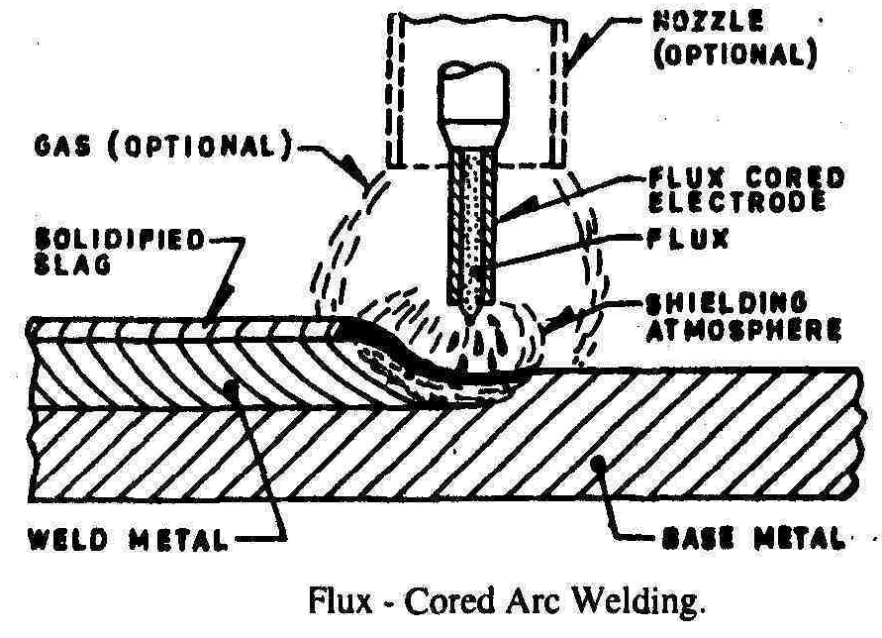
Flux-cored arc welding
Flux-cored arc welding (FCAW)
is a semi-automatic or automatic
arc welding process. FCAW
requires a continuously fed
consumable tubular electrode
containing a flux and a constant
voltage or, less commonly, a constant current welding power supply.
An externally supplied shielding gas is sometimes supplied, but often the flux itself is relied upon to generate the necessary protection from the atmosphere. The process is widely used in construction because of its high welding speed and portability.

Slide 52
Gas Tungsten Arc Welding or (TIG)
(GTAW), or tungsten inert gas (TIG) welding, is a manual welding process that uses a non-consumable electrode made of tungsten , an inert or semi-inert gas mixture, and a separate filler material.
Especially useful for welding thin materials, this method is characterized by a stable arc and high quality welds, but it requires significant operator skill and can only be accomplished at relatively low speeds.
It can be used on nearly all weldable metals, though it is most often applied to stainless steel and light metals.
It is often used when quality welds are extremely important, such as in bicycle, aircraft and naval applications.

Slide 53
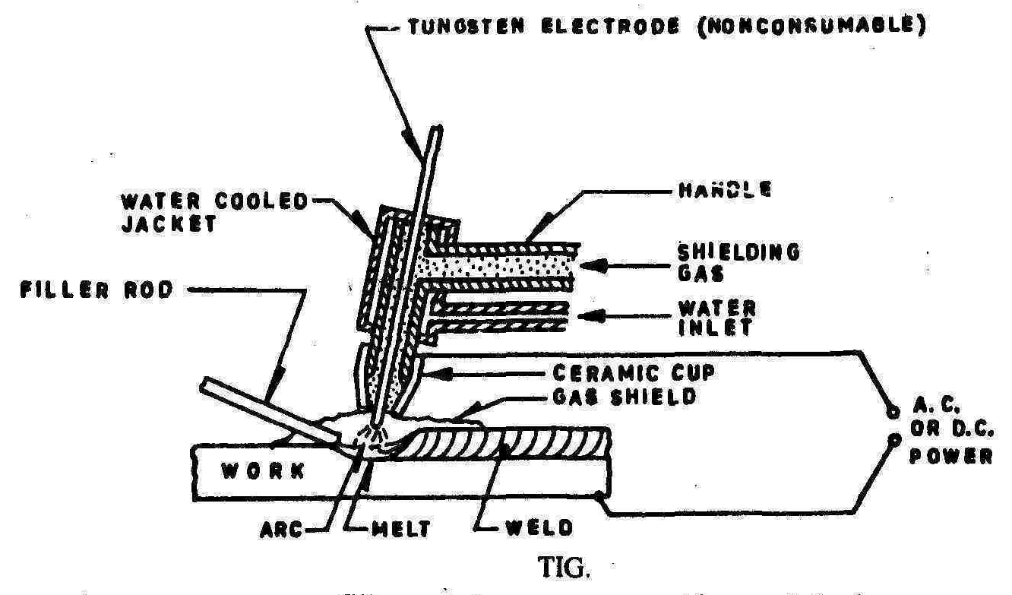

Slide 54
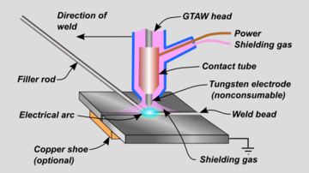

Slide 55
The tungsten electrode has a high melting point that makes it virtually non-consumable. This gives the gas tungsten arc welding specific Advantages:
Welding can be done in any position.
The weld is usually equal to the base metal in composition.
Flux is not used, therefore, finished welds do not require
cleaning of corrosive residue.
Smoke or fumes are not present to obscure vision.
Distortion of the base metal is minimal because the heat is
concentrated in a small area.
No spatter is produced.

Slide 56
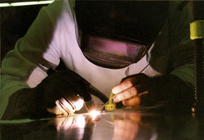

Slide 57
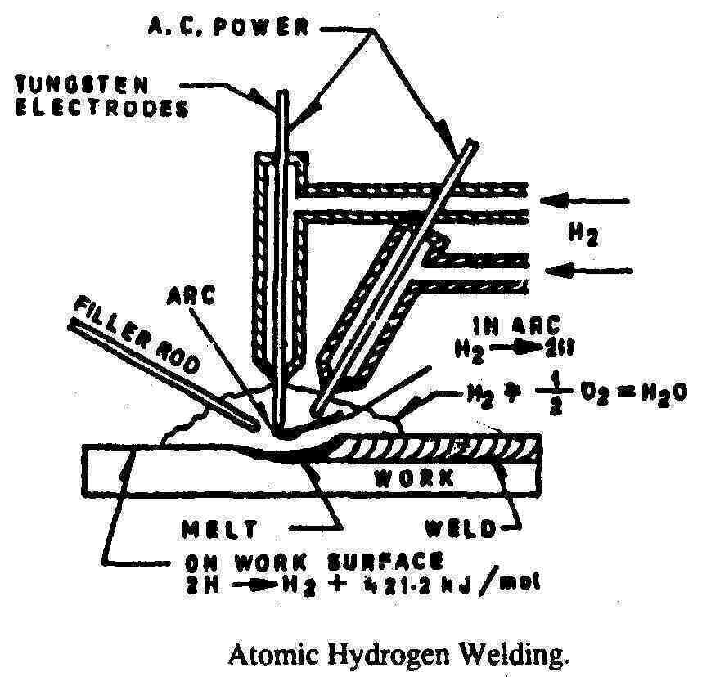
Atomic Hydrogen Welding
In this, the coalescence is
produced by heating with
an electric arc maintained
between two tungsten
electrodes in an atmosphere
of hydrogen. Shielding is
Obtained by hydrogen.
Hydrogen gas flows by the tungsten electrodes in the holder, keeping them cooler and lengthening the electrode life.

Slide 58
Process
In this process an a.c. arc is formed between two tungsten electrodes along which streams of hydrogen are fed to the welding zone. The molecules of hydrogen are dissociated by the high heat of the arc in the gap between the electrodes. The formation of atomic hydrogen proceeds with the absorption of heat:
H₂ = 2H - 421.2 kJ/mol.
This atomic hydrogen recombines to form molecular hydrogen outside the arc, particularly on the relatively cold surface of the work being welded, releasing the heat gained previously :
2H = H₂ + 421.2 kJ/mol.
The metal is heated by the indirect arc and by the heat evolved above, producing a temperature of about 3700 C of the flame..

Slide 59
Application.
Atomic hydrogen welding is mainly used in the welding of very thin sheets or small diameter wires (2 to 10 mm thick)..
Since the arc is struck between two electrodes, non-conducting materials such as ceramics may be arc welded.

Slide 60
RESISTANCE
WELDING

Slide 61
Resistance welding
Heat required for welding is generated by the resistance offered by the metal pieces to the flowing current. Small pools of molten metal are formed at the weld area as high current (1000–100,000 A) is passed through the metal.
In general, resistance welding methods are efficient and cause little pollution, but their applications are somewhat limited and the equipment cost can be high .

Slide 62
RESISTANCE WELDING METHODS:-
1.SPOT WELDING.
2.BUTT WELDING.
3.SEAM WELDING.
4.PROJECTION WELDING.
5.PERCUSSION WELDING.

Slide 63
Spot welding
It is a popular resistance welding method used to join overlapping metal sheets of up to 3 mm thick.
Two electrodes are simultaneously used to clamp the metal sheets together and to pass current through the sheets.
The advantages of the method include efficient energy use, limited workpiece deformation, high production rates, easy automation, and no required filler materials.
Weld strength is significantly lower than with other welding methods, making the process suitable for only certain applications. It is used extensively in the automotive industry—ordinary cars can have several thousand spot welds

Slide 64
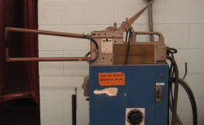
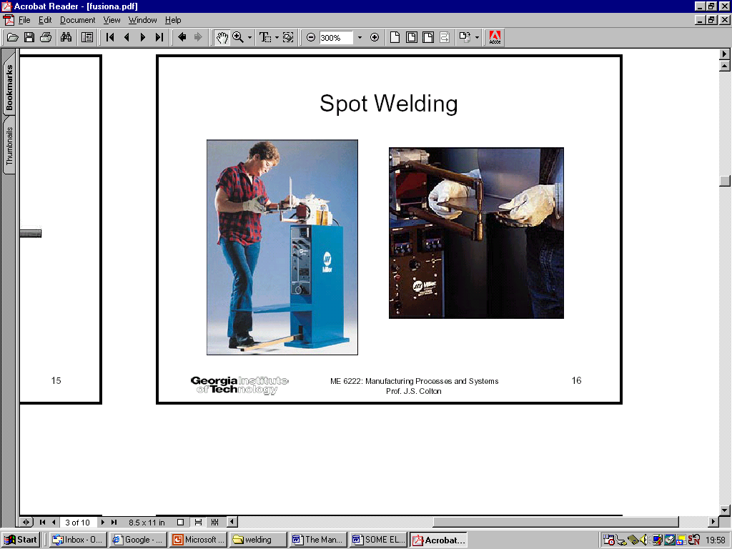
Process Description:-
2 Copper electrodes are used.
Metals to be welded are
pressed between electrodes
Electric resistance at joints
of metal is high.
Heat generated in weld.
Power supplied to the weld
ranges from 6-18 kW for each cm sq. of area.
Used to join overlapping metal Sheets (3-6 mm thickness)

Slide 65
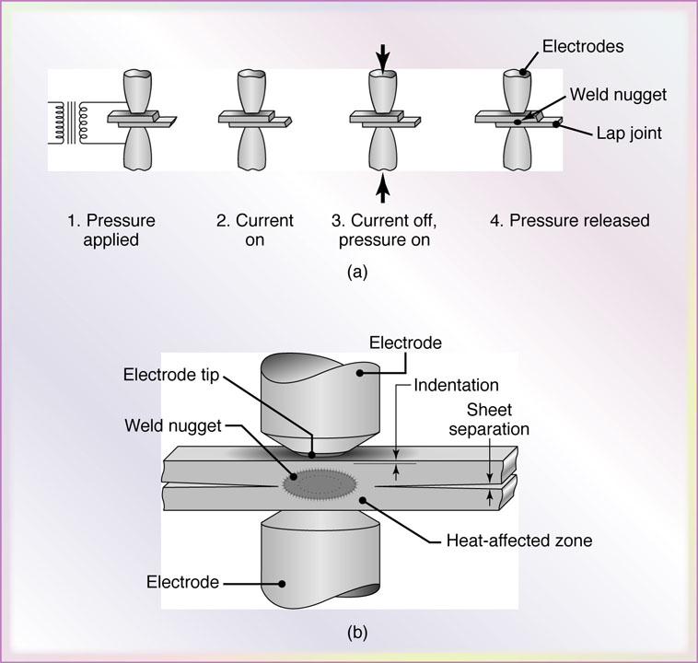
Figure 31.6 (a) Sequence of events in resistance spot welding. (b) Cross-section of a spot weld, showing the weld nugget and the indentation of the electrode on the sheet surfaces. This is one of the most commonly used processes in sheet-metal fabrication and in automotive-body assembly.

Slide 66
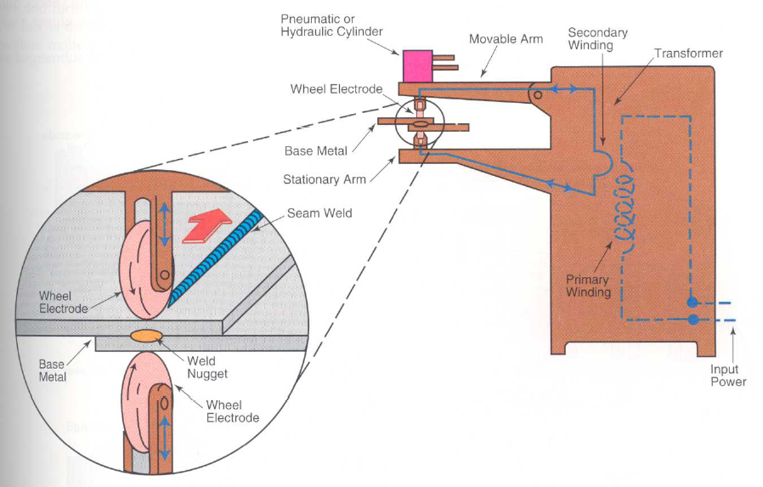
Seam Welding
Like spot welding, seam welding relies on two electrodes to apply pressure and current to join metal sheets. However, instead of pointed electrodes, wheel-shaped electrodes roll along and often feed the workpiece, making it possible to make long continuous welds. In the past, this process was used in the manufacture of beverage cans, but now its uses are more limited.

Slide 67
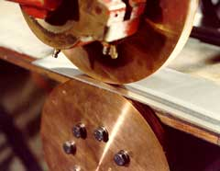
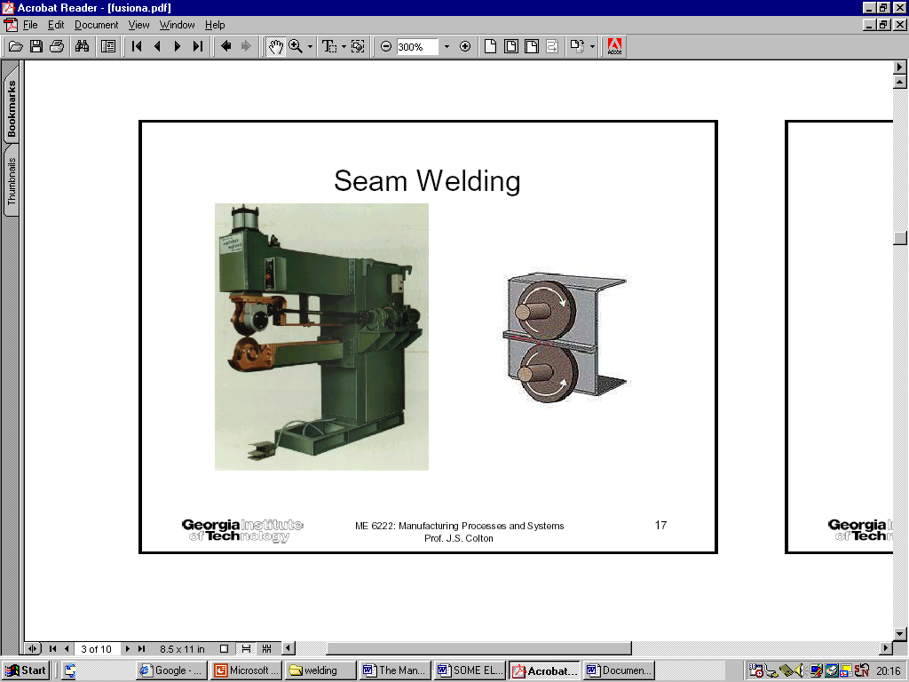
Seam Welding:-
Produces leak tight continuous joints in sheet metals.
Metal pieces held together under pressure by electrodes.
Forms overlapping resistance Spot welds along joint rotating electrodes.
Used for metal of thickness – 0.025 to 3mm.
Notes:
67

Slide 68
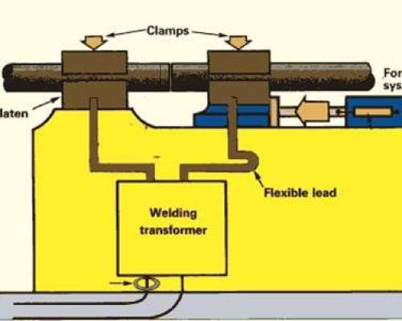
Resistance Butt Welding (Upset)
In this welding, the two pieces to
be joined are held tightly together
and current is applied, so that heat
is generated over the entire area of
to be joined surface.
Pressure is applied throughout the
heating period. The pressure is later on increased when the welding
temperature has been reached.

Slide 69
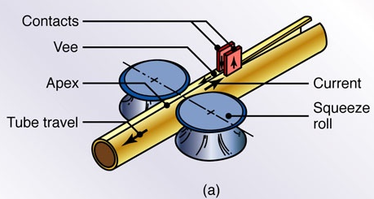
Procedure :
One work piece to joined is clamped in
stationary clamping block and other is clamped
to moving clamping block.
The two work pieces are brought together by pressure.
A heavy current is passed through these work pieces. The heat is generated because of resistance to the flow of electric current.
When the welding temperature has been reached, the pressure is increased so that proper joint takes place.
After that welding current is turned off.
Force is released when the welded joint has reached the desired temperature.
After that work pieces are unclamped.
Applications
1)producing butt joints in tubes ,pipes, etc

Slide 70
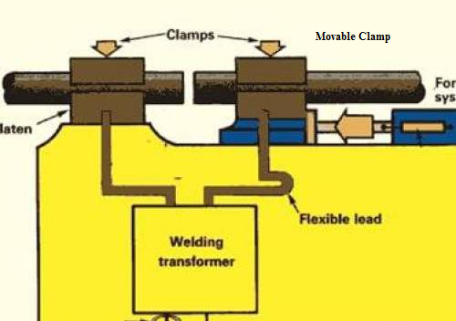
FLASH BUTT WELDING:-
Flash butt welding is similar to upset
welding except that the heat required
for melting is obtained by means of
an arc rather than simple resistance
heating.
Procedure:
One workpiece to joined is clamped
in stationary clamping block and
other is clamped to moving clamping block.
The workpiece held in the movable clamp is moved to bring towards the
stationary workpiece ( untill the light contact has been established).
When the welding current is switched on, flashing is established.
This flashing produces the welding heat.
When sufficient heat is produced ,more pressure is applied so that sound joint takes place.

Slide 71
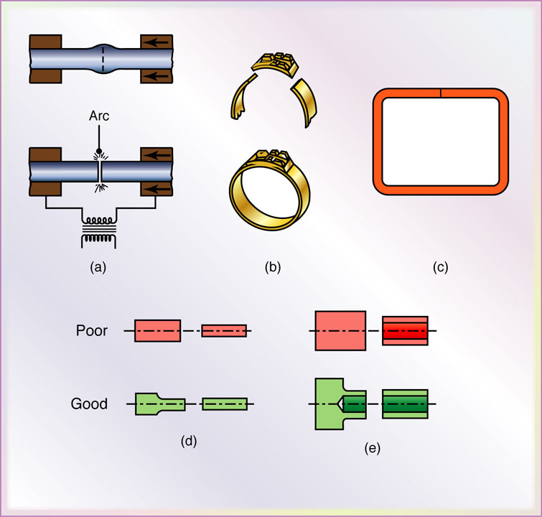
Applications :
It consumes less welding current than Upset butt welding.
Preparation of weld surface is not required.
The process is cheap.
It is a faster process.
Fig : (a)Flash-welding process for end-to –end welding of solid rods or tubular parts
(b) & (c) Typical parts made by flash welding

Slide 72
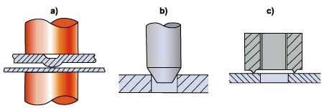
Projection Welding:-
Projection welding is the other form of Spot welding where one sheet to be
joined is provided with number of projections to help localized the current at
predetermined spot.
As the current is switched on , it will pass through these projections.
These projections are melted and are pressed together to complete the weld , by pressing the upper electrode.
The melted projections form the weld.
The welding can be done at several points simultaneously.

Slide 73
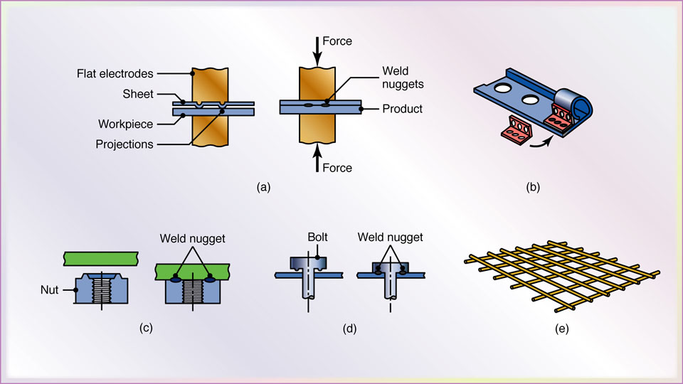

Slide 74
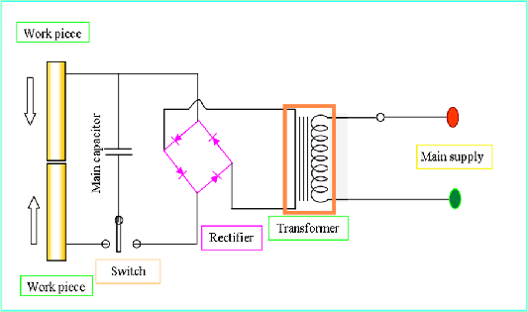
Percussion Welding:
In this process welding heat is obtained from an arc produced by a rapid discharge of stored electrical energy.
Pressure is applied percussively (rapidly) during and immediately following the electric discharge.
The capacitors are used to store electrical energy.

Slide 75
GAS
WELDING

Slide 76
GAS WELDING EQUIPMENT...
1. Gas Cylinders
Pressure
Oxygen – 125 kg/cm²
Acetylene – 16 kg/cm²
2. Regulators
Working pressure of oxygen 1 kg/cm2
Working pressure of acetylene 0.15 kg/cm2
Working pressure varies depends upon the thickness of the work pieces welded.
3. Pressure Gauges
4. Hoses
5. Welding torch
6. Check valve
7. Non return valve

Slide 77
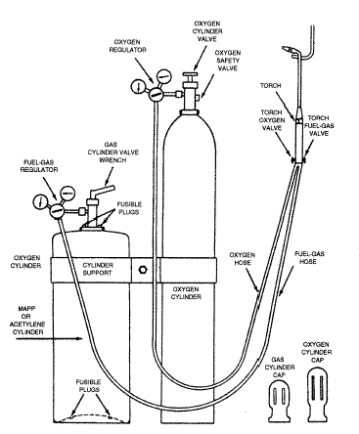
Oxy-Acetylene welding

Slide 78
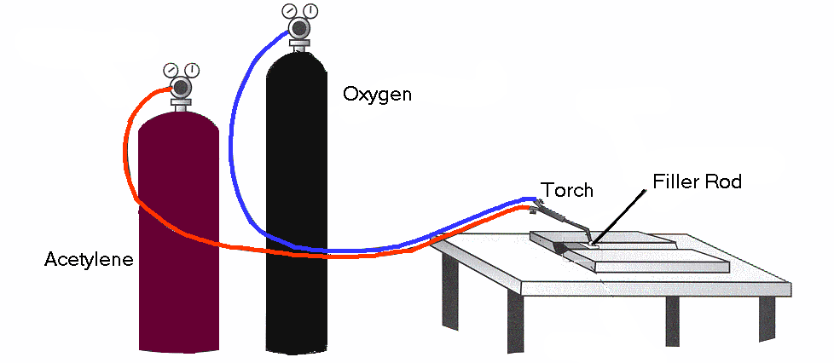
Gas Welding (Oxy-acetylene)
A number of welding processes use a flame produced by burning a mixture of fuel gas and oxygen. The gas usually used is Acetylene but other gases are also used.
CaC₂ + 2H₂O -> Ca(OH)₂ + C₂H₂ + 127.3 k J per mol.
Separate cylinders and a hose pipe from each cylinder transports the gases to a torch.
Gas and fuel mix in the torch
burns @ 3100°C.

Slide 79

During the welding heat from the flame is concentrated on the joint edges until the metal melts and starts to flow. When the molten metal from both sides melts it starts to fuse, when the metal cools down the two parts become Permanently joined
Additional Filler Metal is fed in by hand into the weld pool, at regular intervals where it becomes molten and joins with the parent metal.

Slide 80

The Oxy-acetylene welding Flame
The oxy-acetylene flame has two distinct zones.
The inner zone (Primary combustion Zone) is the hottest part of the flame. The welding should be performed so as the point of the inner zone should be just above the joint edges.
C₂H₂ + O₂ 2CO + H₂
Primary Combustion zone

Slide 81
The outer zone the secondary combustion envelope performs two functions
Preheats the joint edges
Prevents oxidation by using some of the surrounding oxygen from weld pool for combustion and gives off carbon dioxide and water vapour
CO + H₂ + O₂ CO₂ + H₂O
Secondary Combustion zone

Slide 82
TYPES OF FLAMES
Oxygen is turned on, flame immediately changes into a long white inner area (Feather) surrounded by a transparent blue envelope is called Carburizing flame (3000⁰c). Excess acetylene (0.9:1), (Alloy steels and aluminium alloys).
Addition of little more oxygen give a bright whitish cone surrounded by the transparent blue envelope is called Neutral flame (It has a balance of fuel gas and oxygen) (3200⁰c)
Used for welding steels, aluminium, copper and cast iron
If more oxygen is added, the cone becomes darker and more pointed, while the envelope becomes shorter and more fierce is called Oxidizing flame. Excess oxygen (1.5:1).
Has the highest temperature about 3400⁰c
Used for welding brass and brazing operation

Slide 83


Three basic types of oxyacetylene flames used in oxyfuel-gas welding and cutting operations:
(a) neutral flame; (b) oxidizing flame; (c) carburizing, or reducing flame.

Slide 84
Three basic types of oxyacetylene flames used in oxyfuel-gas welding and cutting operations: (a) neutral flame; (b) oxidizing flame; (c) carburizing, or reducing flame.

Slide 85

The Oxy-acetylene welding Flames
Neutral flame
Oxidizing flame
Carburizing flame

Slide 86
Equipment used in O-A welding
The oxygen and acetylene hose pipes
Gases used
Gas pressure Regulators
Flashback arrestor
Welding torch/Welding nozzle
Filler rods and fluxes

Slide 87
The oxygen and acetylene hose pipes
Reinforced rubber hoses.
Acetylene hose has left hand thread couplings and colour coded red.
Oxygen hose has right handed thread couplings and colour coded blue

Slide 88
Gases used
Oxygen extracted from air and compressed into cylinders at high pressure. Cylinder is black. Oil should never be brought into contact and should not be used on fittings
Acetylene (C₂H₂) is a fuel gas. Cannot be compressed directly as explodes at high pressures. Cylinders are packed with porous material which is filled with acetone Acetone absorbs acetylene. Cylinder colour coded maroon

Slide 89

Gas Pressure Regulators
One gauge indicates the pressure of the cylinder and the other indicates the pressure in the supply pipe to the torch.

Slide 90

Welding torch
Oxygen and acetylene are delivered to the torch by separate hoses. Each gas is controlled by a valve on the torch. The two gases mix in the torch and after they are ignited burn at the nozzle.
Mixer
Needle valves

Slide 91

Flashback Arrestors
These are positioned on both the fuel gas and oxygen supply between the hose and the regulator. Their purpose is to prevent the return of a flame through the hose into the regulator.

Slide 92
Filler Rods and fluxes
Filler rods are used when additional filler metal is required in the weld area they come in different diameters.
Fluxes protect the weld pool from contamination by oxygen and nitrogen, they are normally in paste form placed on a heated filler rod before welding begins

Slide 93
GAS CUTTING
Ferrous metal is heated in to red hot condition and a jet of pure oxygen is projected onto the surface, which rapidly oxidizes
Oxides having lower melting point than the metal, melt and are blown away by the force of the jet, to make a cut
Fast and efficient method of cutting steel to a high degree of accuracy
Torch is different from welding
Piercing, used to cut a hole at the centre of the plate or away from the edge of the plate

Slide 94


GAS CUTTING…
Automatic Gas Cutting
Manual Gas Cutting

Slide 95


Some Other welding Process
Ultrasonic welding is used to connect thin sheets or wires made of metal or thermoplastic by vibrating them at high frequency and under high pressure.
Explosion welding involves the joining of materials by pushing them together under extremely high pressure. The energy from the impact plasticizes the materials, forming a weld, even though only a limited amount of heat is generated.
Friction stir welding

Slide 96
SOLDERING and
BRAZING

Slide 97
Brazing and Soldering
Brazing
It is a low temperature joining process. It is performed at temperatures above 840º F and it generally affords strengths comparable to those of the metal which it joins. It is low temperature in that it is done below the melting point of the base metal. It is achieved by diffusion without fusion (melting) of the base
Brazing can be classified as
Torch brazing
Dip brazing
Furnace brazing
Induction brazing

Slide 98

Brazing

Slide 99
Advantages & Disadvantages
Advantages
Dissimilar metals which cannot be welded can be joined by brazing
Very thin metals can be joined
Metals with different thickness can be joined easily
In brazing thermal stresses are not produced in the work piece. Hence there is no distortion
Using this process, carbides tips are brazed on the steel tool holders
Disadvantages
Brazed joints have lesser strength compared to welding
Joint preparation cost is more

Slide 100

Soldering
It is a low temperature joining process. It is performed at temperatures below 840ºF for joining.
Soldering is used for,
Sealing, as in automotive radiators or tin cans
Electrical Connections
Joining thermally sensitive components
Joining dissimilar metals

